Slide 1
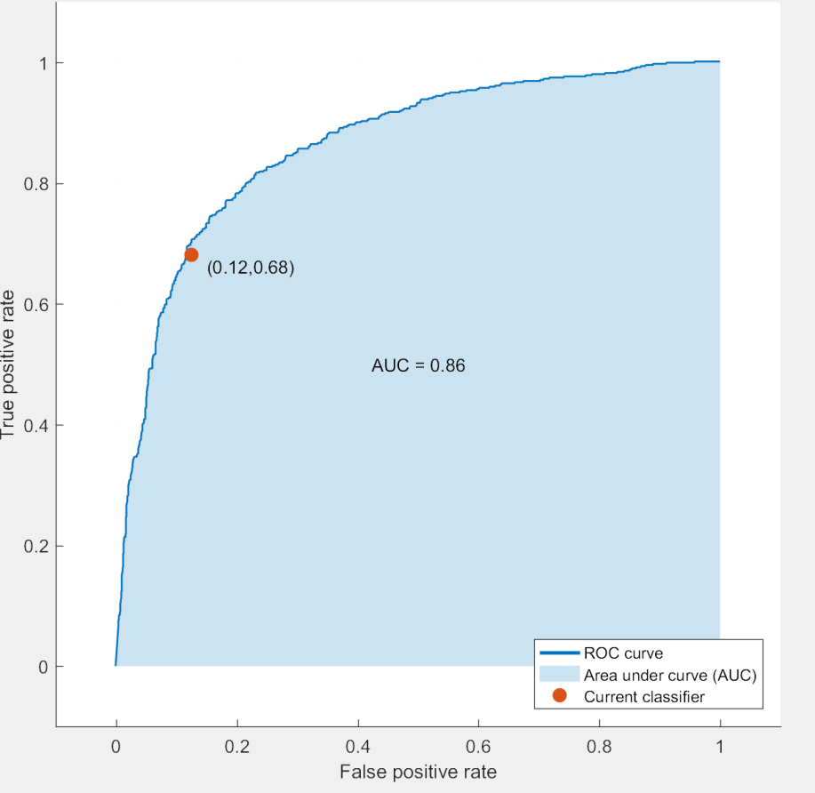
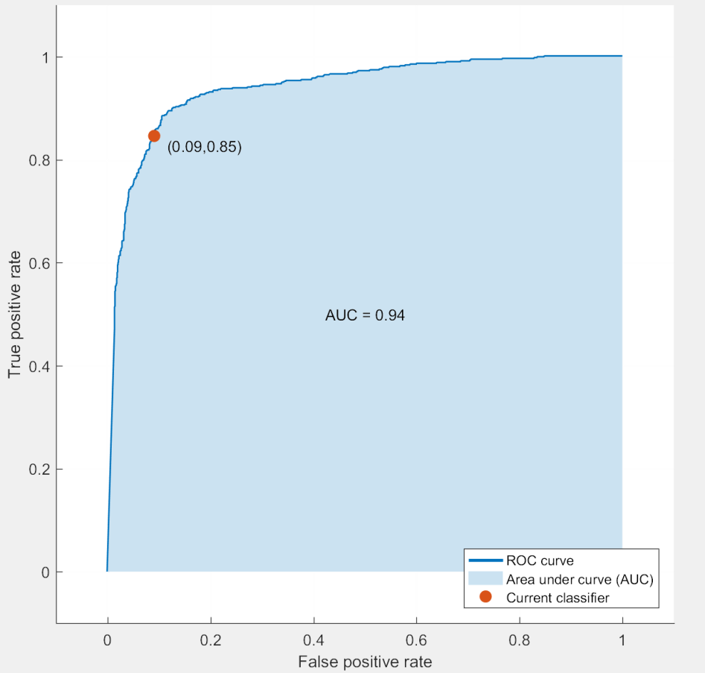
Keystroke Dynamics for Human Identification
Maurice Shih, Steven Lin, Victoria Wang
Stanford University, Dept. of Computer Science
maurices@stanford.edu, STEVENL9@stanford.edu , vwang16@stanford.edu
Introduction
Model
Results and Discussion
Passwords are often maliciously obtained and used to impersonate people. Our project aims to classify computer users according to their typing patterns (haptics). By analyzing the timing of key presses for sequences of words, we hope to be able to differentiate between different people typing. We examine the flight time (the time between keypresses), and the press time(the duration of time each key is pressed) in sequences of letters as features to identify users by. For our project, we pursued two different types of typing dynamics classifiers: a single-word classifier and a multi-word classifier.
Single-word classifier:
We use a model where for each user-input string of length n , we store the features in the form: (c, character[1], press time[1], flight time[2], character[2], press time[2], …, flight time[n], character[n], press time[n]) where c is a constant replacing the flight time before the first letter.
Multi-word classifier:
We use a 3-gram model with a size (27^3)*5 feature vector. For each user-input string of length n, there are n - 2 datapoints consisting of each 3-letter combination in the word. Each datapoint represents a three-character gram (i.e. “aaa”, “aba”, “aab”...) with 5 distinct features associated with each: The two flight times between the 3 letters, and each press time.
Typed String
Single Word Classifier:
We used a support vector machine with 25% cross validation. This lead to a 92.77% success rate, meaning that given a dataset containing the typing haptics of multiple people, it accurately identified the type of a chosen data point 92.77% of the time.
Multi-word Classifier:
The algorithm of k-nearest neighbors obtained success 74.4 rate for individual “3-grams”.
For the support vector machine we obtained success 74.6 rate for individual “3-gram”.
Since a new string will contain multiple 3-grams, the identification rate for a string of a longer length than 3 will be much less than the prediction rate for the 3-gram, since it can compare the predicted typee for each 3 gram and take the most reported one. For example, identifying the typist for a 5 letter word would have an error rate of 83.92.
“Password”
FT , “P”,DT, FT, “a”, DT , FT, “s”, DT, FT, “s”, DT, …..
1, 80, 92, 82, 65, 141, 69, 83, 58, 92, 83, 76, 126, 87, 75, 23, 79, 75, 28, 82, 62, 88, 68, 97,
Single-Word Classifier
Data Collection
Multi-word Classifier
1, 80, 92, 82, 65, 141, 69, 83, 58,
1, 65, 141, 69, 83, 58, 92, 83, 76,
1, 83, 58, 92, 83, 76, 126, 87, 75,
1, 83, 76, 126, 87, 75, 23, 79, 75,
1, 87, 75, 23, 79, 75, 28, 82, 62,
1, 79, 75, 28, 82, 62, 88, 68, 97,
To collect user typing haptic data, we built a windows application to measure the flight and press time of each letter in milliseconds as the user types as it runs. The data is recorded to a CSV file, where each word populates a line of data. For our multi-word classifier, an additional “3-gram” matlab script parses this text file and breaks it into combinations of 3 letters that appears in the given word. For example, “Password” would be broken down as follows:
We asked ten other people to use this application to type the string “password” fifty times, recording the results in multiple CSV files as training data for our single-word typing classifier.
For our multi-word typing classifier, we had three people type paragraphs of over a thousand words. We input this data into the “3-gram” script.
Algorithm
Conclusion
Single word Classifier:
For each pair of users, we created a binary classifier with linear kernel. For example, given an input and 3 users, A, B, and C, we would run three classifiers, one comparing A and B, another for B and C, and lastly A and C to see which user the input matched the best with.
The single-word classifier could potentially be useful for password identification; the multi-word classifier could be used for general user identification (ex. identifying users of military-owned computers). Both our classifiers have pretty good performance. However, for the multi-word classifier, it would be beneficial to test the algorithm on more test subjects to see if variance within an individual interferes with classification correctness. It would also be interesting to try n-gram models where n does not equal 3.
Combination | Flight time between 1st two letters | Press time of 1st letter | Flight time between 2nd two letters | Press time of 2nd letter | Press time of 3rd letter
“pas” | 70 | 27 | 118 | 46 | 36
“ass” | 118 | 46 | 57 | 91 | 41
“ssw” | 57 | 91 | 81 | 132 | 90
“swo” | 81 | 132 | 86 | 26 | 32
“wor” | 86 | 26 | 64 | 29 | 28
“ord” | 64 | 29 | 64 | 83 | 110
Fig. 1: For the Multi-word classifier, running the data though an SVM generated these ROC curves for each person. The sharper the curve, the more accurately the SVM identifies a typee
Acknowledgements
Multi-word Classifier:
We used a k-nearest neighbors algorithm is to look at the k nearest points that an input data point has to the training data. Based on what classification these neighbors are, we classify the input as value more of its neighbors have. To determine how close points are, we use squared inverse.
The basis of the support vector machine for the multi-word classifier is to use a kernel to transform the data onto a hyperplane, dividing the data into two portions. We used a one vs all multiclass method and a Gaussian kernel:
K(x,x')=exp(-||x-x‘||^2).
We would like to thank David Sanchez of SRI for the inspiration for our project. This project was also made possible by the many volunteer typees we had to help us generate data. Finally, we would like to acknowledge Percy Liang and the rest of the CS221 teaching team for the AI knowledge that formed the basis for our endeavor.

